Slide 1
Lightning Talk #2
Flight price prediction

Slide 2
problem statement
Airline ticket prices fluctuate significantly, and travelers may pay substantially different prices for the same route depending on factors such as the airline, departure time, arrival time, number of stops, travel duration, seat class, and booking lead time. These pricing variations make it difficult for customers to determine whether they are purchasing a ticket at a reasonable price and save in some cases up to 25% of the ticket price.
The objective of this project is to analyze the factors influencing airline ticket prices and develop a machine learning model to predict ticket prices based on flight characteristics. By providing accurate price estimates with error rate do not exceed 10%, the model aims to support travelers in making more informed booking decisions and identifying lower-cost alternatives when multiple flight options are available.

Slide 3
Business Goals
Predict price by analyzing the key factors that influence airline ticket prices and train models to predict based on the analysis.
Machine Learning Goals
Develop a regression model capable of predicting airline ticket prices using flight characteristics.
Help travelers make more informed booking decisions by providing estimated ticket prices.
Compare multiple regression models algorithms (Linear Regression, Decision Tree, Random Forest, and XGBoost) to identify the best-performing model.
Evaluate model performance using Mean Absolute Error (MAE), Root Mean Squared Error (RMSE), and the Coefficient of Determination (R²).
Assess the impact of feature engineering by comparing baseline and engineered feature sets
Identify the flight characteristics associated with lower and higher ticket prices.
Project Goals

Slide 4
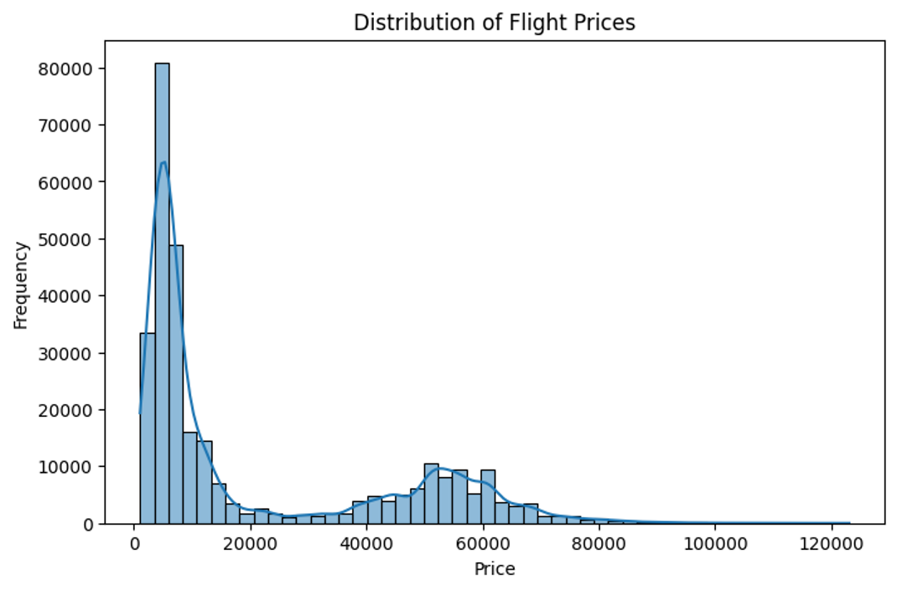
+30K records
Target: Price
Min price:$1105
Max price:$123.07K
Mean:$20.9K
Findings
Median:$7.4K
regular prices <$100K

Slide 5
Findings
Missing values
No missing values (nulls)
Outliers
Price(target): 123 outliers
Duration: 2110
Class imbalance:
The target is regression
Class balancing is not something to study with regression.
Days_left: No outliers

Slide 6
Original data frame VS engineered data frame
Original
engineered
Categorical features (8)
Airline
flight
source_city
destination_city
departure_time
arrival_time
Stops
Class
Categorical features (8)
Airline
source_city
destination_city
departure_time
arrival_time
Stops
Class
Route
Numerical features (3)
duration
days_left
Route-frequency
Numerical features (2)
duration
days_left

Slide 7
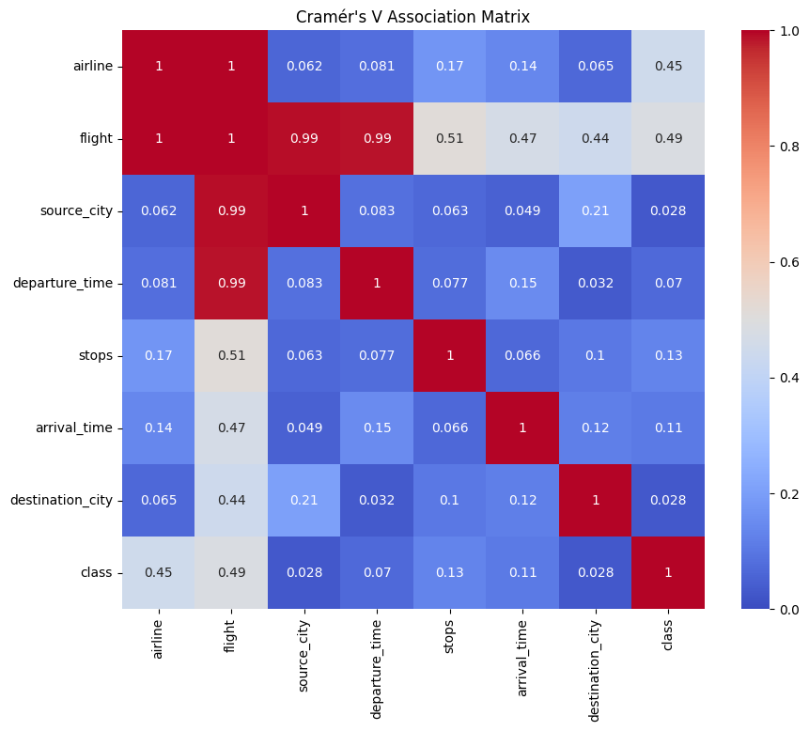
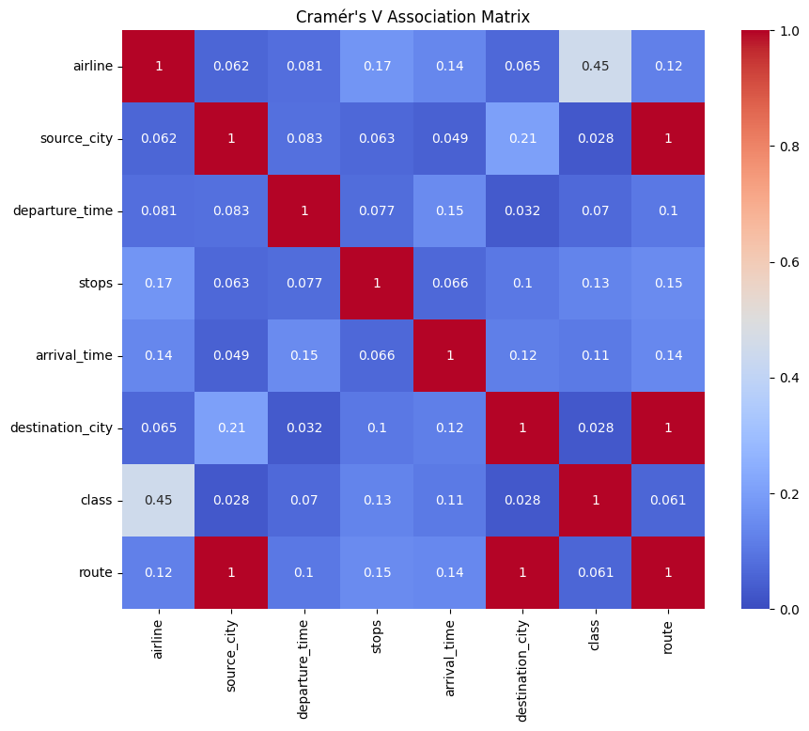
Original categorical features correlations
Engineered categorical features correlations

Slide 8
Numeric features Correlations with target (price):
Numeric features
Original
Duration
route_frequency
days_left
0.20
-0.09
-0.04
Engineered
(not significant negative correlation)
(not significant negative correlation)
(weak positive correlation)

Slide 9
Categorical features Correlations with price
Rank | Feature | F-statistic | Significance | Interpretation
1 | Class | 2,192,425 | p < 0.001 | Strongest predictor of ticket price.
2 | Airline | 17,194 | p < 0.001 | Very strong.
3 | Stops | 6,477 | p < 0.001 | The number of stops has a strong influence on ticket price.
4 | Arrival Time | 1,013 | p < 0.001 | Arrival time has a significant effect on ticket pricing.
5 | Departure Time | 319 | p < 0.001 | Departure time contributes to price variation.
6 | Destination City | 193 | p < 0.001 | Destination has a statistically significant but smaller effect.
7 | Source City | 145 | p < 0.001 | Source city also influences pricing, although less strongly.
8 | Route | 86 | p < 0.001 | Route remains significant, but its effect overlaps with other pricing factors.
ANOVA showed that all categorical features have a statistically significant relationship with ticket price (p < 0.05).
Among them, seat class exhibited the strongest influence, followed by airline and the number of stops, indicating that these features are likely to be the most informative predictors in the regression models.

Slide 10
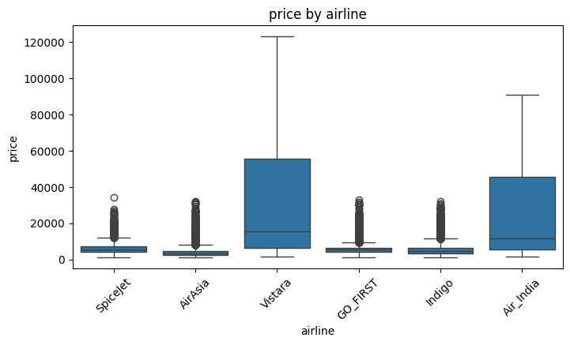
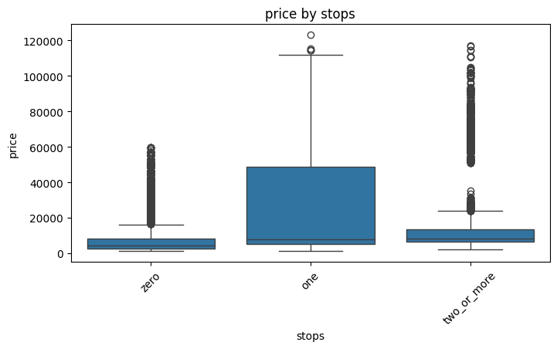
Correlations with target(price):
Airline: Vistara & Air_india cost the maximum prices
Stop: if the flight has on stop it costs the maximum price

Slide 11
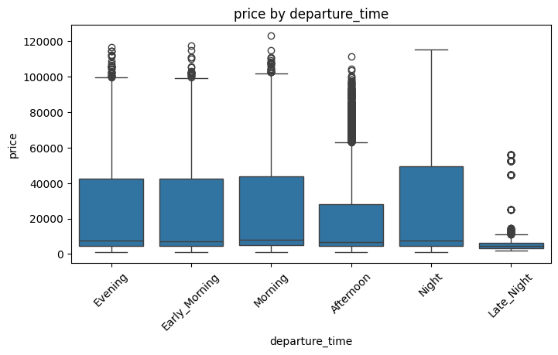
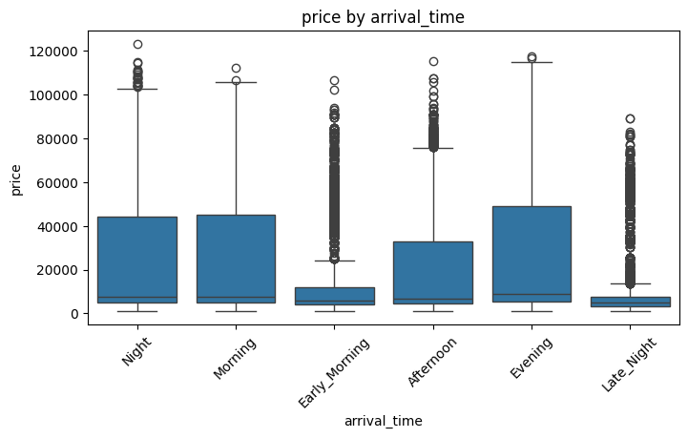
Correlations with target(price):
Departure time: Late night & Afternoon cost the minimum prices
Arrival time: Late night & early morning cost the minimum prices

Slide 12
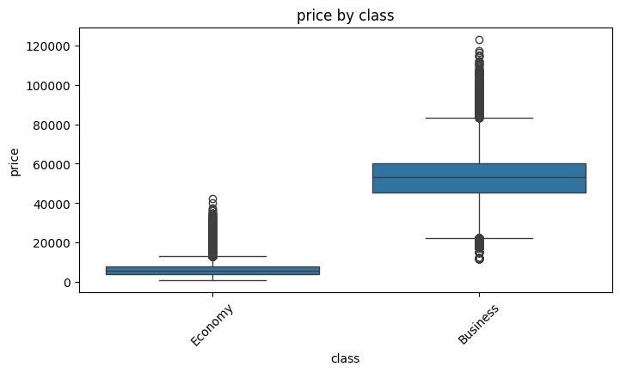
Correlations with target(price):
Class: the business class is much more expensive price than the economy class

Slide 13
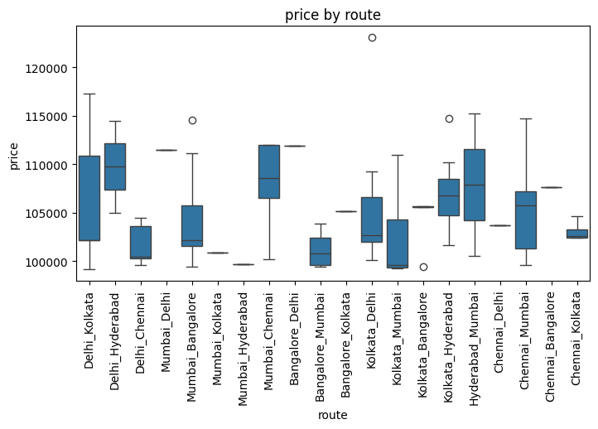
Correlations with target(price):
We can see some routes are significantly cheaper than other routes

Slide 14
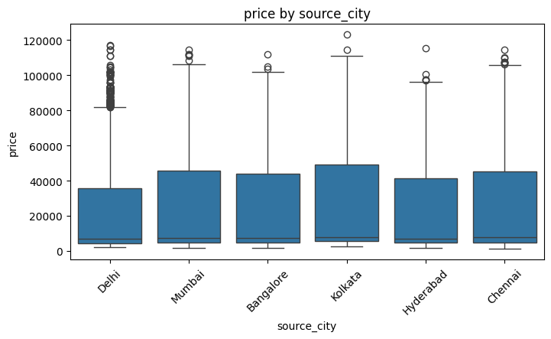
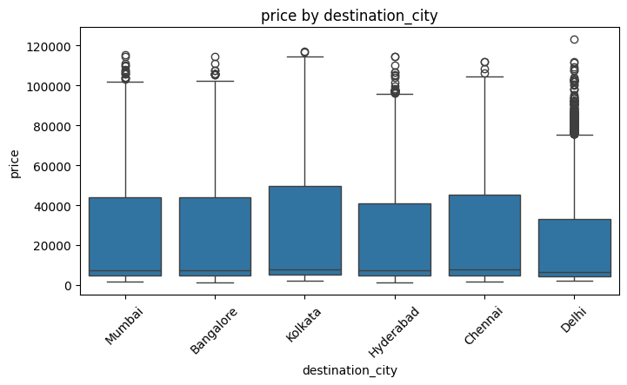
Correlations with target(price):
Source and destination city factors: do not affect that much, we can see they almost have the same lower bound and the upper bound can vary a little.

Slide 15
Outliers:
Price
123 outliers
Duration:
2110 outliers
These values were retained because they represent valid premium pricing rather than data errors.
Further investigation showed they represent legitimate long-duration flights rather than data errors. The outliers were retained to preserve real-world pricing patterns and avoid losing valuable information.

Slide 16
Planing
Preprocessing
Label encoding for stops because it is ordinal feature (0,1, 2+)
Model approach
Hot encoding for all other categorical features
Scaling for only linear regression using standard scaler
Models: regression models candidates
Evaluation metrics:
Linear regression
Decision tree
Random forest
XGboost
MAE (Mean Absolute Error)
RMSE (Root Mean Squared Error)
R²: (Coefficient of Determination)
Data frame
First will use baseline data frame without flight, this is important also for linear regression.
Then use it with route and route frequency keeping source and destination cities.
Then keep route and remove source and destination cities.

Slide 17
models
Model | Strength | Limitation
Linear Regression | Simple, fast, interpretable, establishes a baseline | Assumes linear relationships and may underfit complex pricing patterns.
Decision Tree | Captures nonlinear relationships and interactions | Overfitting, it could memorize instead of studying the relationships.
Random Forest | Combines many decision trees to reduce overfitting and improve generalization | Less interpretable and computationally heavier than a single tree.
XGBoost | sequentially improves previous trees, often achieving the best predictive performance | More computationally intensive and requires hyperparameter tuning for best results. finding good settings takes more time and experimentation than models like Linear Regression.

